Slide 1
Mendocino Triple Junction and Stress Regime In The Nepalese Himalaya Using GMT
Jessica Dozal

Slide 2
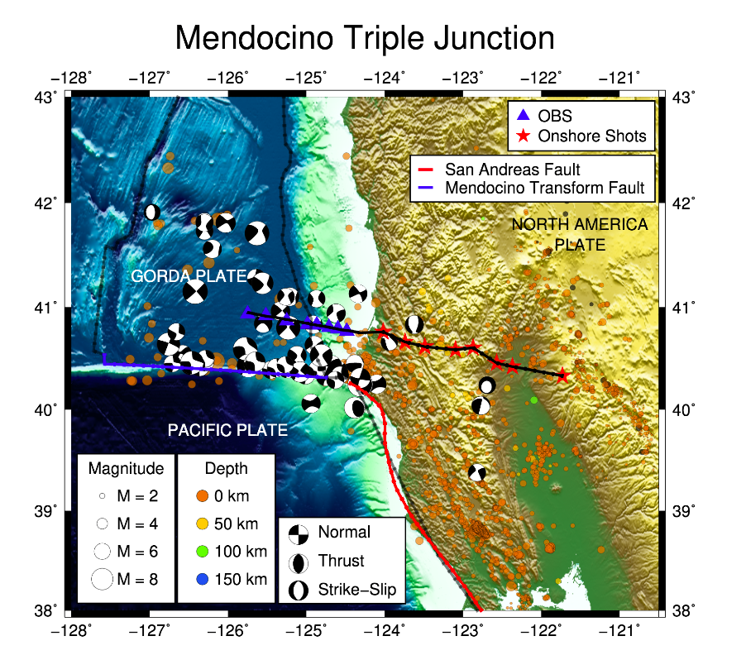
Mendocino Triple Junction
The MTJ is an actively deforming region experiencing high seismic activity. By analyzing offshore and onshore seismic wide-angle reflection and refraction data north of the MTJ and creating P-wave velocity models using datasets, the aim is to assess potential fault ruptures associated with highly impacted regions. This research represents an important contribution to understanding earthquake hazard in Northern California.
Notes:
We examine offshore and onshore seismic wide-angle reflection and refraction data north of the Mendocino Triple Junction (MTJ) offshore northern California. The MTJ is an actively deforming region experiencing high seismic activity. We image subsurface structures to the North of the MTJ region by creating P-wave velocity models using datasets collected in 1993 to 1994 during the MTJ seismic experiment (Trehu et al., 1995). The velocity models we produce offer insight into the structure and composition of both the Gorda and North American plates as well as the plate boundary megathrust in the region. We aim to assess potential fault ruptures associated with highly impacted regions. Modeling will be done using RAYINVR and Hole’s code to construct a 2-Dimensional (2-D) P-wave velocity model and 3-Dimensional (3-D) tomographic models from travel time inversion and amplitude modeling (Zelt and Smith, 1992). Previous studies have created offshore P-wave velocity models using ocean bottom seismometer (OBS) data and onshore P-wave velocity models using onshore wide-angle, explosive-source seismic data. We will merge these datasets to create true offshore-onshore P-wave velocity models. Changes in P-wave velocities will likely illuminate subsurface geology and tectonics north of the MTJ beneath the Cascadia subduction zone region. As we study an area with a high rate of seismicity – including frequent events greater than Mw5.0 (Mori et al, 1997) – this research represents an important contribution to understanding earthquake hazard in Northern California.

Slide 3
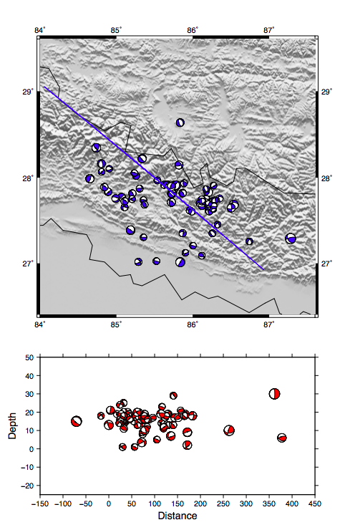
Stress Regime In The Nepalese Himalaya From
The two recent earthquakes, April 25, 2015 Mw ~7.8 (Gorkha earthquake) and May 12, 2015 Mw ~7.2, at the Indo-Eurasian plate margin killed thousands of people and caused billion dollars of property loss. In response to these events, a dense array of seismometers to record the aftershocks along Gorkha earthquake rupture area were deployed.
We are manually picking the P-wave first motion arrival polarity to develop a catalog of focal mechanisms for the larger magnitude (>M3.0) events with adequate (>10) arrivals. We hope to characterize the seismicity and stress mechanisms of the complex fault geometries in the Nepalese Himalaya and to address the geophysical processes controlling seismic cycles in the Indo-Eurasian plate margin.

Slide 4

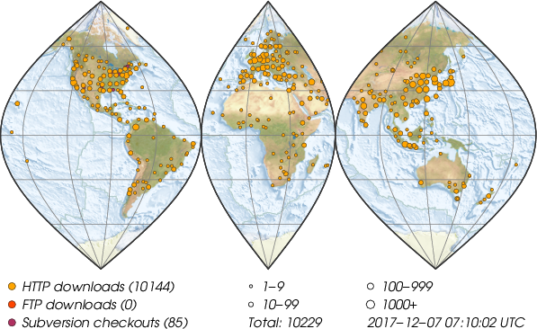
What is GMT?
GMT is an open source collection of about 80 command-line tools for manipulating geographic and Cartesian data sets (including filtering, trend fitting, gridding, projecting, etc.) and producing PostScript illustrations ranging from simple x–y plots via contour maps to artificially illuminated surfaces and 3D perspective views.
Notes:
Considering its flexibility at no charge, people worldwide are using GMT in their work and at home. Most users of GMT are Earth or ocean scientists, but there are apparently no limits to the kind of applications that may benefit from GMT: We know GMT is used in medical research, engineering, physics, mathematics, social and biological sciences, and by geographers, fisheries institutes, oil companies, a wide range of government agencies, and last but not least innumerable hobbyists.
Map from The map above illustrates the spreading of the current GMT release around the world based on web traffic.

Slide 5
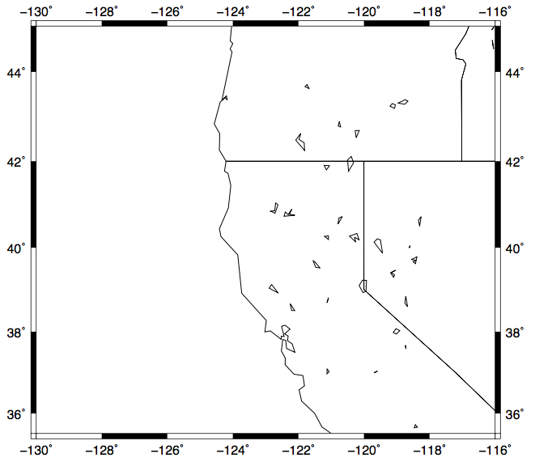
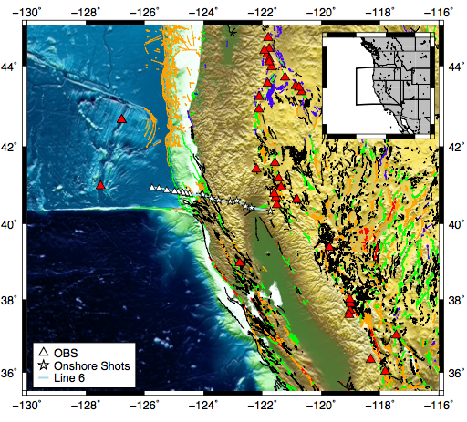
Example GMT Map

Slide 6
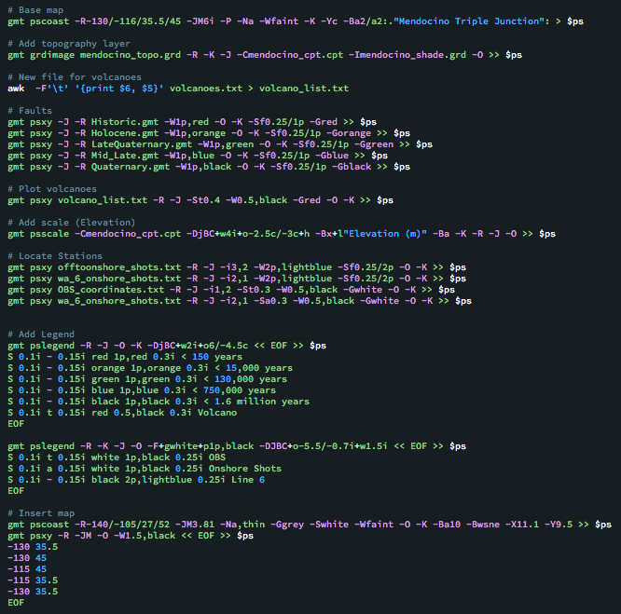
1. Start with a base map

Slide 7
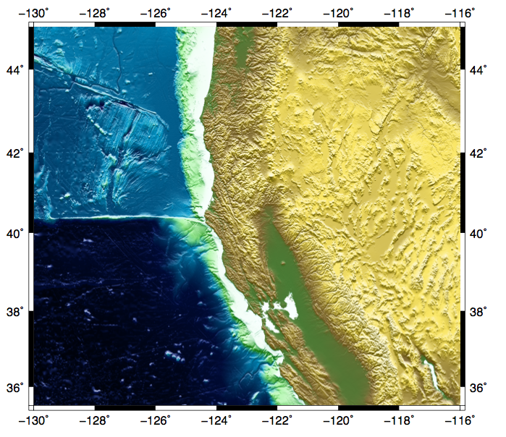
2. Add Topography

Slide 8
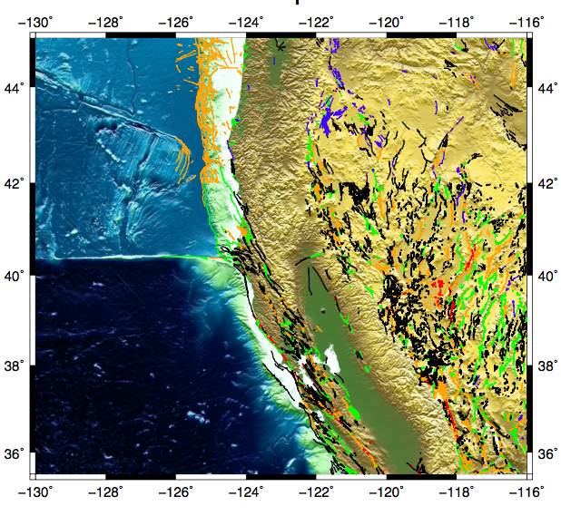
3. Add Faults

Slide 9
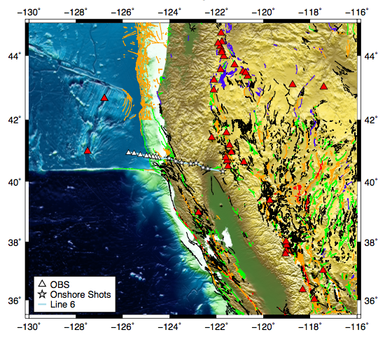
4. Add Volcanoes and Stations

Slide 10
5. Insert legends and baby map

Slide 11
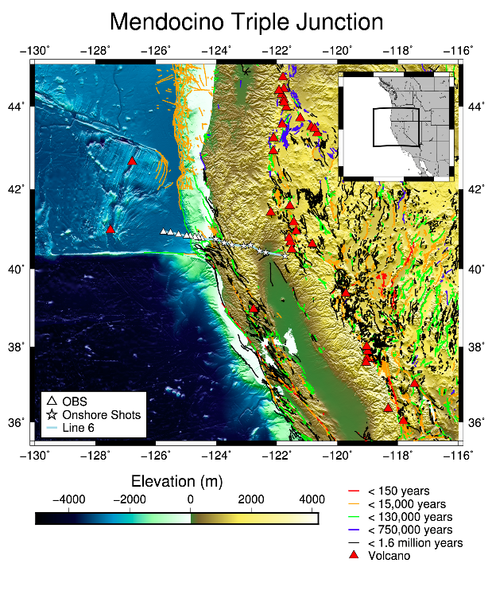

Slide 12
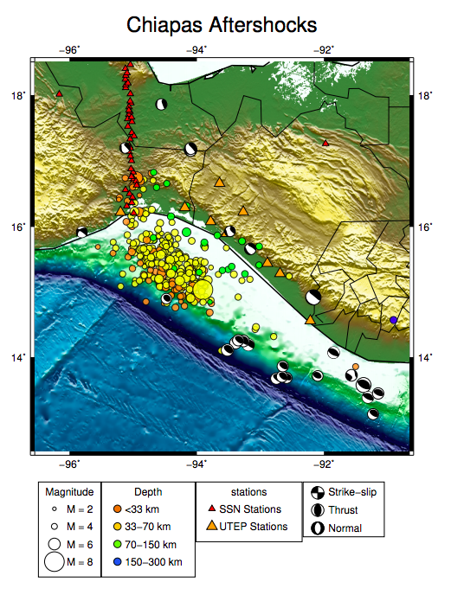
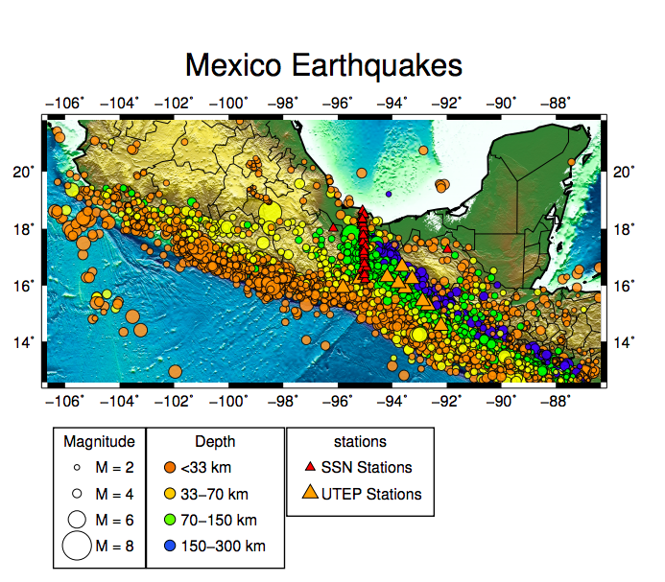

Slide 13
Future work
Fast track (Software Development)
Learning Antelope (Data collection and seismic data analysis)
Helping with GMT

